Slide 1
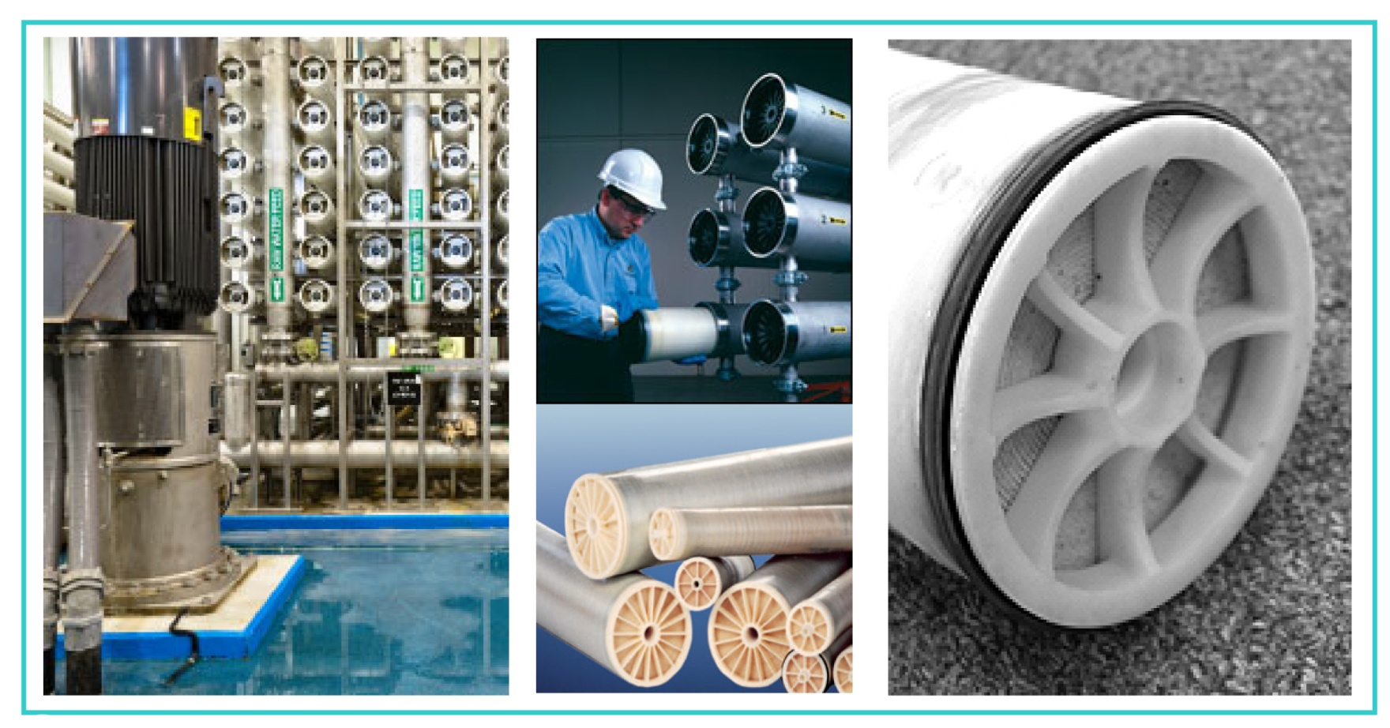


FILTER MEMBRANE CLEANING
FOOD & BEVERAGE –– WASTEWATER –– LABORATORY –– PHARMACEUTICAL –– CONTRACT MANUFACTURING
201 Connecticut Drive, Burlington, NJ 08016 USA Ph (609) 386-8770 Fax (609) 386-8438 www.ipcol.com mkt@ipcol.com

Slide 2

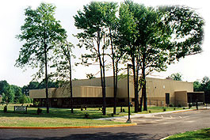
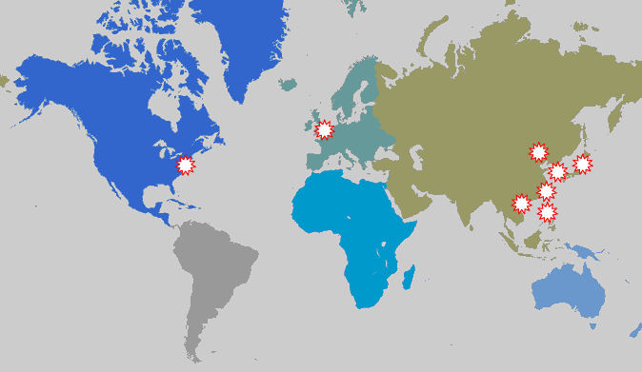
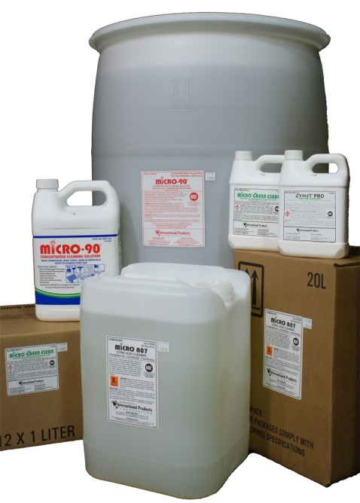

Presenter Overview
International Products Corporation, incorporated in 1923, manufactures specialty cleaners and lubricants. The company has a history of over 30 years of successful selling to the filter membrane industry.
All products are manufactured in the U.S.A. in their New Jersey headquarters and are available worldwide.
An ISO 9001:2008 Certified Company
Filter Membrane Cleaning

Slide 3
Today’s Agenda
Global Water Supply Dilemma
Industries’ Challenges
Industries’ Alternatives
General Overview of Chemical Effects on Membranes
Cleaners
Laboratory Cleaning Trials / Case Scenario
Conclusions
Questions
Filter Membrane Cleaning
Slide Number
3

Slide 4
Water, Water, Water
Our most vital natural resource (after air)
Fixed amount of water on earth
Significant supply disparity worldwide
Usage varies significantly
Gallons/capita/day/country: 1 – 145
Need for potable water will continue to escalate
Increase in world population
1900 – 1.65 b
2000 – 6.1b
2050 projection: 7.5b – 10.6b
Increase in agricultural products
70% water for crops
Greater energy demands
Changes in lifestyle
Source: United Nations, NY 2004, Dept of Economic and Social Affairs. World Populations to 2300
Filter Membrane Cleaning
Slide Number
4

Slide 5
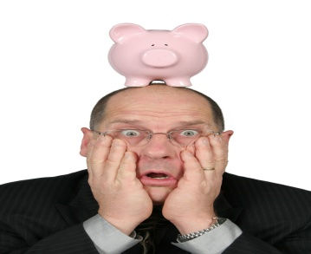
Industries’ Challenges
20% water used in industries’
Regulatory requirements
MARPOL Treaty, FDA, USDA, EPA, CEFAS, local regulations, etc.
Economic Pressures
Reduced resources, staff, etc.
Minimize downtime / Maximize ROA
Desalination and water re-use on the rise
Filter Membrane Cleaning
Slide Number
5

Slide 6
KEEP THOSE MEMBRANES WORKING!!!

Slide 7
Decisions, Decisions, Decisions
Crisis control or preventive maintenance?
Sustainable?
Trial and Error?
Outsource?
“Let them worry about it”
Lose competency
Lose control
Partnership with specialty chemical manufacturer?
Filter Membrane Cleaning
Slide Number
7

Slide 8
There IS Help! ! !

Slide 9
Membrane Cleaning Basics

Slide 10
General Membrane Compatibility & Performance Factors
Chlorine tolerance
Temperature
Pressure
pH
< 2; > 10.5
Solvent cleaners
Cationic surfactants
Low HLB nonionics
Filter Membrane Cleaning
Slide Number
10

Slide 11
Membrane Fouling
Mechanism
Most membrane surfaces are negatively charged
Van der Waal forces of soils create a hydrophobic attraction to the negative membrane surface
Salt bridges – multivalent cations allow for a denser soil layer to coat the membrane
Soils
Natural organic matter
Proteins
Biofilm
– Multivalent cations
– Polymers
– Scale
Filter Membrane Cleaning
Slide Number
11

Slide 12


Cleaning Mechanism
Introduce functional groups to the fouling layer
Creates an electostatic repulsion from the membrane surface
Hydrophilic in nature
Cleaner types
Caustic
Bleach
Oxidizers
Enzymes
_
_
_
_
_
_
OIL
Surfactants
Acids
Chelants (EDTA)
Formulated mixtures
_
_
_
_
Slide Number
12

Slide 13

Cleaner Manufacturers
Commodity Manufacturer
Specialty Manufacturer
Make (import) and sell one chemical
Sulfuric Acid, Caustic
Each chemical targets one type of soil
Initial lower costs
Formulated blends of ingredients
Tested, proven, consistent, synergy
Economical in long run
Each product attacks many soils
Product / Cleaning regimen tailored to specific application
Certified quality assurance program
Technical expertise
Customer assistance
Filter Membrane Cleaning
Slide Number
13

Slide 14
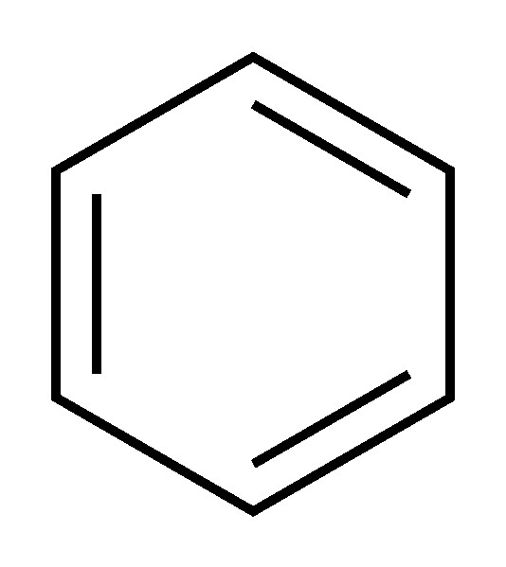
Alkaline and Acid
Alkaline Cleaners
Acid Cleaners
pH > 9
pH < 4
Effective against oils and greases
Effective against metals (iron, calcium, magnesium), oxides, inorganics, scale
Surfactants and Builders
Citric Acid
Anionic and nonionic surfactants
Dissolve/emulsify oils and greases
Builders and alkalinity
Improves detergency
Improves water quality
Allows surfactants to work better
Safe choice of acid
Organic
Compatible
Biodegradable
Non-corrosive
H O
O
+ HCl
H₂O; NaCl
Cl⁻⁻
Na⁺
O
O⁻⁻
Na⁺
Filter Membrane Cleaning
Slide Number
14

Slide 15
To chelate or not to chelate?
Assets
Improves water quality
Grabs metals
Increases detergency
Alkaline and acid types
Liabilities
Sequestered metals pass through membranes
Many don’t biodegrade
pH extremes
Filter Membrane Cleaning
Slide Number
15

Slide 16
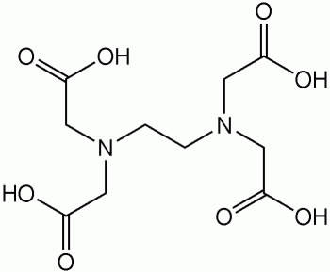
The most prevalent chelant ─ EDTA
When EDTA recovery is necessary,
Precipitate EDTA with acid
Precipitate metals by reduction / oxidation
Precipitate metals with high pH or sulfide
Displace metal with another
Proprietary polymers eliminate metals/chelant
OR CHOOSE
- Effective biodegradable chelants
Filter Membrane Cleaning
Slide Number
16

Slide 17
When to clean your membranes?
10% RULE
Pressure increases up to 10%
Flux decreases up to 10%
Permeate quality decreases up to 10%
Filter Membrane Cleaning
Slide Number
17

Slide 18
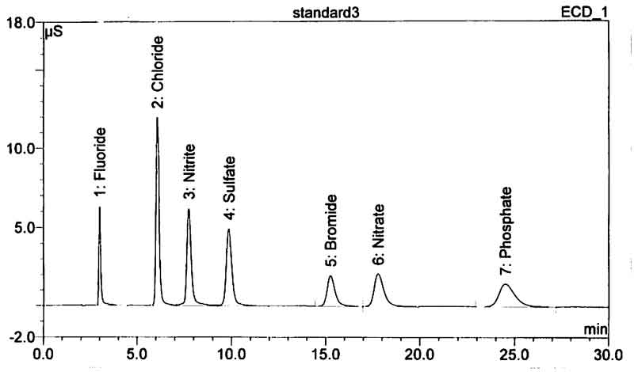
Permeate Quality
Methods:
Typical IC Chromatogram of Anions
HPLC / IC
Conductivity
Hardness
pH
Total dissolved solids
Filter Membrane Cleaning
Slide Number
18

Slide 19
Match soil to cleaner - Soils in Major Industries
Industry | Primary Foulant | Secondary Foulant(s) | Cleaner Type(s)
Municipal Wastewater | Oils, greases, scale, natural organic matter | Metals | Alkaline
Metalworking (Industrial Waste Water) | Oils, greases, salts | Metals | Alkaline or Acid
Pharmaceutical | Proteins Oils | Oils Proteins | Enzyme or Alkaline
Dairy | Milkstone | Protein | Acid or Enzyme
Food | Oils Protein | Protein Oil | Alkaline or Enzyme
Filter Membrane Cleaning
Slide Number
19

Slide 20
Laboratory Cleaning Experiments
Equipment used:
Cross flow benchtop filtration unit
Membrane used:
Polyethersulfone UF 5000 MWCO
Foulants used:
Emulsified coolant
Make-Up Water:
RO or hard water (200 ppm) as indicated
2% Cleaner concentration at room temperature
Typical baseline flux values:
~ 35 Gal/ft2/day
Standard rinse cycle:
One hour at 200 PSIGs
Standard fouling and cleaning cycle:
Thirty minutes at 400 PSIGs
Filter Membrane Cleaning
Slide Number
20

Slide 21
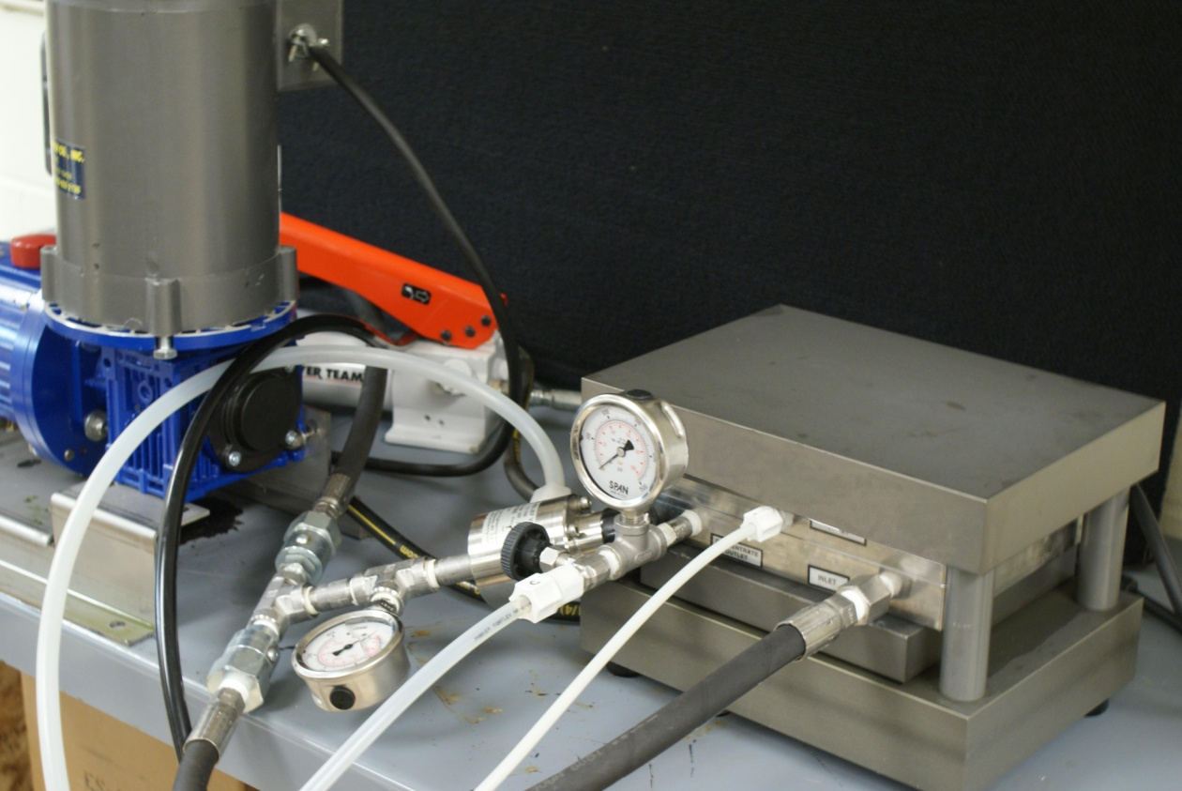
IPC’s Membrane/Cleaner Evaluation Unit
Filter Membrane Cleaning
Slide Number
21

Slide 22
Favorable vs. Unfavorable
Cleaning Profile
Base | Foul | Rin1 | Rin2 | Rin3 | Clnr | Rin1 | Rin2 | Rin3 | Rin4
Filter Membrane Cleaning
Slide Number
22

Slide 23
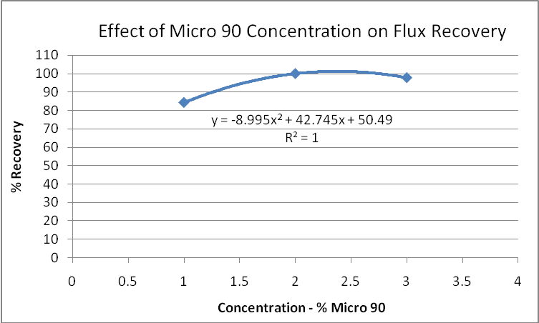
Optimal Effect of Formulated Product*
on Flux Recovery
Concentration - % formulated product *
According to the Concentration / % Recovery curve a concentration of 2.4% formulated product* will theoretically provide optimal cleaning performance in this situation (101.26% Recovery).
*Micro-90® Concentrated Cleaning Solution
Filter Membrane Cleaning
Slide Number
23

Slide 24
Synergy of Formulated Membrane Cleaner
1 + 1 = 3!
Conclusion :
The formulated cleaner has better results than its individual components.
Filter Membrane Cleaning
Slide Number
24

Slide 25
Flux Recovery by Cleaner Type and by Water Quality
Water Quality
Conclusion:
Water quality affects detergency.
Match cleaner to soil
Filter Membrane Cleaning
Slide Number
25

Slide 26
Matching Cleaner to Soil Type
Conclusion:
It is important to match your cleaner to your soil – different cleaners perform better on different soils.
Filter Membrane Cleaning
Slide Number
26

Slide 27
The Effects of Using Cleaners in Series
Flux vs. Cleaner Series and Water Quality
RO Water
Hard Water (200 ppm)
Conclusion:
Water quality affects flux.
Alkaline followed by acid is best in this trial.
What’s Next?
Optimal concentration of cleaners
Filter Membrane Cleaning
Slide Number
27

Slide 28
Case Study: Overview
Bilge water treatment customer switched to a d’limonene based cleaner
Pleasant fragrance
Better oil / water separation
Better flux results
Worked faster
Lab test:
100,000 MWCO membrane – modified polyacrylonitrile (PAN)
Formulated alkaline cleaner with d’limonene
Filter Membrane Cleaning
Slide Number
28

Slide 29
Case Study: Comparison of Cleaners Lab-Scale Cross Filtration Membrane
Original Alkaline Cleaner
D`Limonene Based Cleaner
Filter Membrane Cleaning
Slide Number
29

Slide 30
Case Study: Microscopic Evaluation
14,720x magnification
Organic and iron oxide particles
Ridge developed from top -center to bottom-left of the membrane
Conclusion: D’Limonene-based cleaner is not recommended for this cleaning application
Slide Number
30

Slide 31
Conclusions
Formulated cleaners offer many benefits
Custom-formulated – Performance tested
Compatibility tested – Consistency
Quality assurance – Long-term performance
Specialty manufacturers
Technical know-how – Performance / compatibility tests
– Share knowledge to keep experience in-house
Filter Membrane Cleaning
Slide Number
31

Slide 32
Contact Us
Contact us to request free cleaner samples.
Lab Trials / Membrane Compatibility tests also available.
International Products Corporation
201 Connecticut Drive, Burlington NJ 08016 USA
Telephone: 609-386-8770 Facsimile: 609-386-8438
Email: mkt@ipcol.com Website: www.ipcol.com
Thank you!
Filter Membrane Cleaning
Slide Number
32

