Slide 1
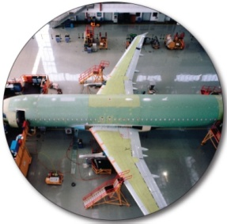
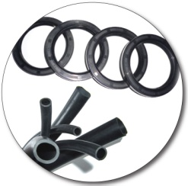




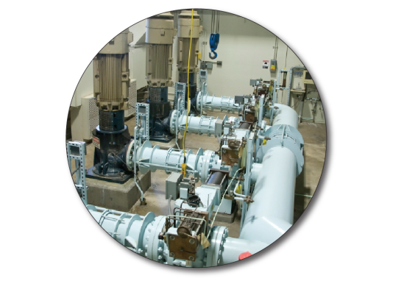

P-80 Rubber Assembly Lubricants
Providing Assembly and Cleaning Solutions since 1923
160811

Slide 2
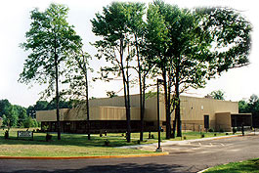


Company Overview
International Products Corporation (IPC), incorporated in 1923, manufactures specialty chemicals. IPC has over 90 years experience manufacturing and selling precision cleaners and formulated lubricants to various industries.
All products are manufactured in the U.S.A. at their New Jersey headquarters and are available worldwide. International Products Corporation is an ISO 9001:2008 Certified Company
Company Headquarters
Distributor Locations

Slide 3
Why Use Rubber Assembly Lubricants
Rubber materials are inherently difficult to install, remove, or otherwise manipulate – even when wet
Common Assembly Problems Include
Rolling O-rings
Uneven cuts
Misaligned parts
Damaged parts
Sore muscles, worker injury
Repetitive Stress Injury (RSI)

Slide 4
A Rubber Lubricant Should:
Reduce Installation Force
Reduce surface tension
Slide parts into place easily, providing a tight fit
Achieve Closer Fits
Design lower tolerance parts
Increase torque installation
Temporary lubrication only ─ resulting in a tight fit
Improve Product Performance
Reduce or eliminate damage to parts
Increase Production Rates
Allow for faster, more productive assembly

Slide 5

A Rubber Lubricant Should:
Avoid Injuries
Avoid musculoskeletal, slippage, and repetitive stress related injuries
Safe to handle
Reduce Rejects
Must be compatible with surfaces and liquids with which it may come in contact
No shrinking, softening, swelling, crazing or rusting
Should dry without residue when properly applied
Environmentally Friendly, Easy to Dispose

Slide 6
Items to Consider when Choosing a Lubricant
Surface compatibility
Metals
Elastomers
Plastics
Dry time
Lubricant conductivity
Chemical composition concerns

Slide 7
Types of Commonly Used Lubricants
Soap and Water
Alcohol
Kerosene
Silicone
Petroleum Oil
Petroleum Jelly
New, ester based, biodegradable choices

Slide 8
Efficiency of Lubricants
Solvents (e.g. alcohol) Provide poor lubrication, are flammable with high VOCs and are a safety risk
Soaps and detergents provide a nominal amount of lubricity but reactivate when wet
Petroleum distillates lubricate, but are often not compatible with surfaces – and are not temporary
Ester technology provides excellent reduction in friction, temporary lubrication, environmental and worker safety.
Comparison of Lubricants
%
%
Formulated Water and Ester Emulsion
Petroleum Oil Based Lubricant
Formulated Surfactant Based Lubricant
Soap and Water
Solvents

Slide 9
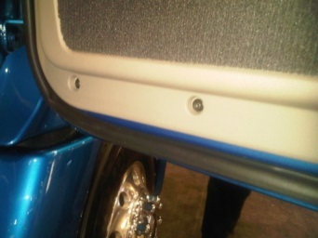
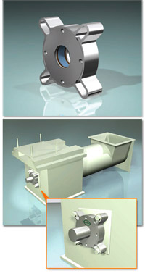
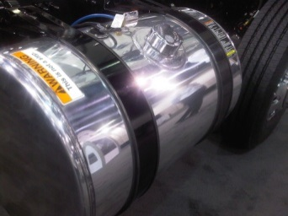
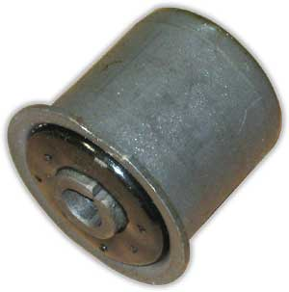
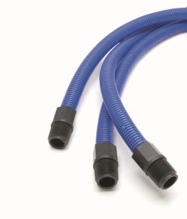
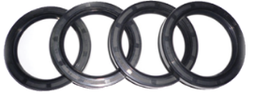
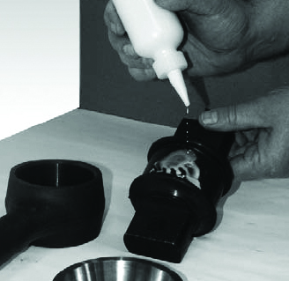
Typical Rubber Assemblies
Belts
Boots
Bumpers
Bushings
Diaphragms
Fasteners
Foam grips
Gaskets
Grommets
Hoses
Insulators
Mounts
O-rings
Plugs
Rubber moldings
Seals
Sleeves
Threaded connectors
Tires
Rubber washers
Wire harnesses
…And hundreds of other rubber and soft plastic parts

Slide 10
Why Use a Specially Formulated Temporary Rubber Lubricant?
Consistent Composition
Low Impurities
Green Chemistry
Favorable Compatibility
Petroleum-based products have a tendency to swell certain rubbers and damage plastics
Soap and water can cause corrosion and future slippage when wet
Silicon interferes with coating and painting

Slide 11
Formulated Temporary Rubber Assembly Lubricants
Why esters?
Molecular structure is conducive to lubrication
Structurally flexible functional groups; C-O-C bonds can rotate easier than other functional groups
Performance over volume ─ a little goes a long way
Do not fluoresce
Improving leak test results

Slide 12
Formulated Temporary Rubber Assembly Lubricants
Innovative Emulsion Technology
Synthetic esters blended with water
Why an emulsion?
Synergy!
Emulsion has better lubrication than esters by themselves
Reduces surface tension of rubber to allow esters to get into all of the nooks and crannies of the rubber
Allows a thin layer of esters to coat the rubber for hydrodynamic lubrication
Temporary lubrication – Once water evaporates, ester film absorbs into elastomer

Slide 13
Lubricant Comparison Chart
ESTER BASED TEMPORARY RUBBER ASSEMBLY LUBRICANTS | TRADITIONAL RUBBER ASSEMBLY LUBRICANTS
Provide lubricity and reduce friction. | Provide lubricity and reduce friction.
Temporary lubrication, once dry will not reactivate, resulting in tight fitting parts. | Continual lubrication, can reactivate in presence of water ─ resulting in problems with quality and consistency of finished product.
Will not dry out rubber or corrode metal parts. | Can dry out rubber and corrode metal parts.
Any residue is non-conductive. | Many additives are conductive.
Non flammable, negligible VOCs. | May contain VOCs. May be flammable.
Excess lubricant washes away easily. | In some cases may be difficult to wash away excess lubricant.
Compatible with elastomers and plastics. Will not swell rubber. | May not be compatible with elastomers and plastics. Can swell rubber.
Treated surfaces can be coated and painted afterwards. | May interfere with downstream coating and painting processes.
Environmentally friendly and non-hazardous. | Environmental and health hazards can exist.

Slide 14
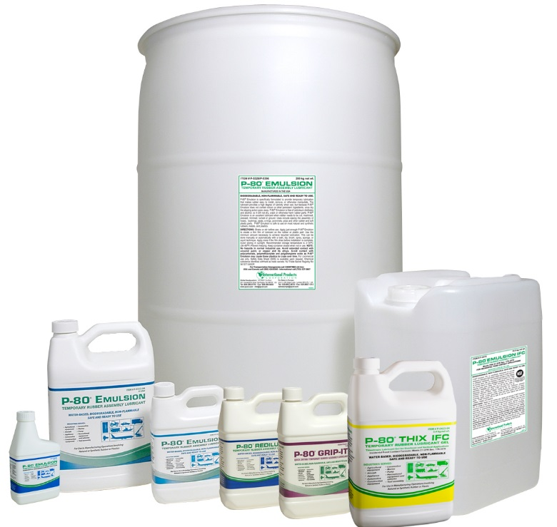
IPC’s P-80® Family of Temporary Rubber Assembly Lubricants
P-80® Emulsion Temporary Rubber Assembly Lubricant
P-80® THIX Temporary Rubber Lubricant Gel
P-80® Grip-it Quick-Drying Temporary Rubber Assembly Lubricant
P-80® RediLube Temporary Rubber Assembly Lubricant
P-80® Emulsion IFC* Temporary Rubber Assembly Lubricant
P-80® THIX IFC* Temporary Rubber Lubricant Gel
*IFC for Incidental Food Contact Applications. Registered with NSF for use in USDA H1 applications and meet FDA regulation 21 CFR 178.3570 which controls lubricants in contact with food surfaces.

Slide 15
P-80® Temporary Rubber Assembly Lubricant Product Specifications
 | P-80® EMULSION | P-80® THIX | P-80® GRIP-IT | P-80® REDILUBE | P-80® EMULSION (IFC) | P-80® THIX (IFC)
Viscosity, cps @ 25° C | 150 | 12,000 | 20 | 20 | 150 | 15,000
Biodegradable | Yes | Yes | No | Yes | Yes | Yes
Reduction of Friction | ~70% | ~70% | ~40% | ~55% | ~70% | ~70%
Estimated minimum dry time | 1 hour | 2 hours | 20 minutes | 20 minutes | 1 hour | 2 hours
pH (neat) | 7.5 to 9.5 | 7.5 to 9.5 | 9.8 to 11.3 | 7.5 to 9.5 | 7.5 to 9.5 | 8.2 to 9.4
Appearance | Milky white to beige | White to beige gel | Clear, colorless | Milky white to light yellow | Milky white to beige | White to beige gel
Shelf life | 2 years | 2 years | 2 years | 1 year | 2 years | 2 years

Slide 16
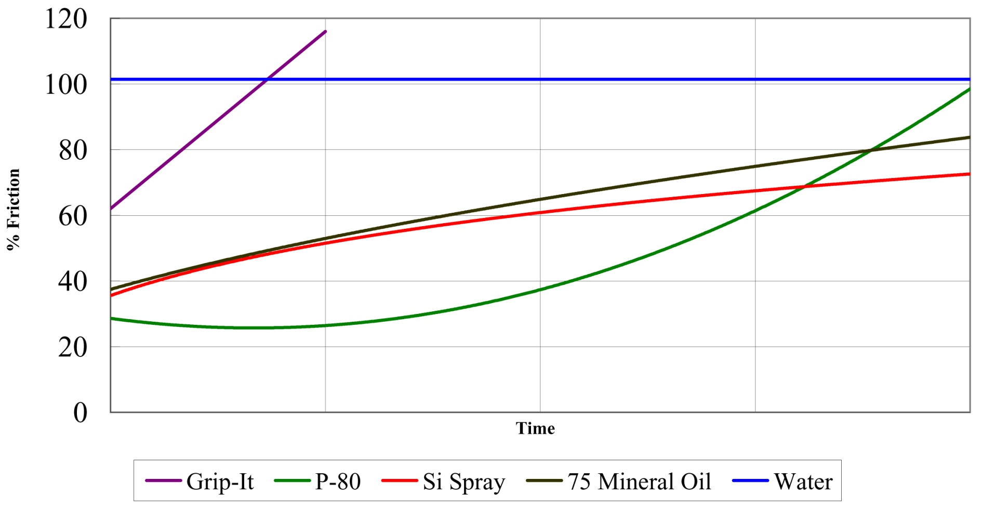
Lubrication over time chart

Slide 17

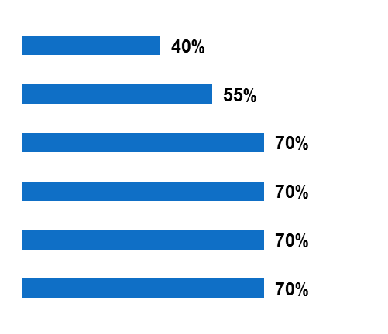
Lubrication -vs- Drying Time
REDUCTION OF FRICTION
ESTIMATED MINIMUM DRY TIME
P-80 Grip-it
P-80 Grip-it
20 Minutes
P-80 RediLube
P-80 RediLube
20 Minutes
P-80 THIX (IFC)
P-80 THIX (IFC)
2 Hours
P-80 Emulsion (IFC)
P-80 THIX
2 Hours
P-80 THIX
P-80 Emulsion (IFC)
1 Hour
P-80 Emulsion
P-80 Emulsion
1 Hour
Reduction of friction data was created using a force gauge comparing both the dry and wet removal forces of hoses on an end cap. The equipment used; Mecmesin AFG 1000N force gauge, a Mecmesin Multi Test 2.5-d automatic test stand, and accessories to hold the cap and hose in place. The test stand is set to a fixed speed and path distance to control variability.

Slide 18
Benefits of P-80®
Reduces friction during assembly
Improves ergonomics and avoids injuries
Increases outputs and reduces rejects
Obtains closer fits
Safe and economical to use
Once dry, will not re-lubricate, even in the presence of water
Compatible with most surfaces
No petroleum distillates
No silicon or CFCs
Ready to use – no need to dilute

Slide 19
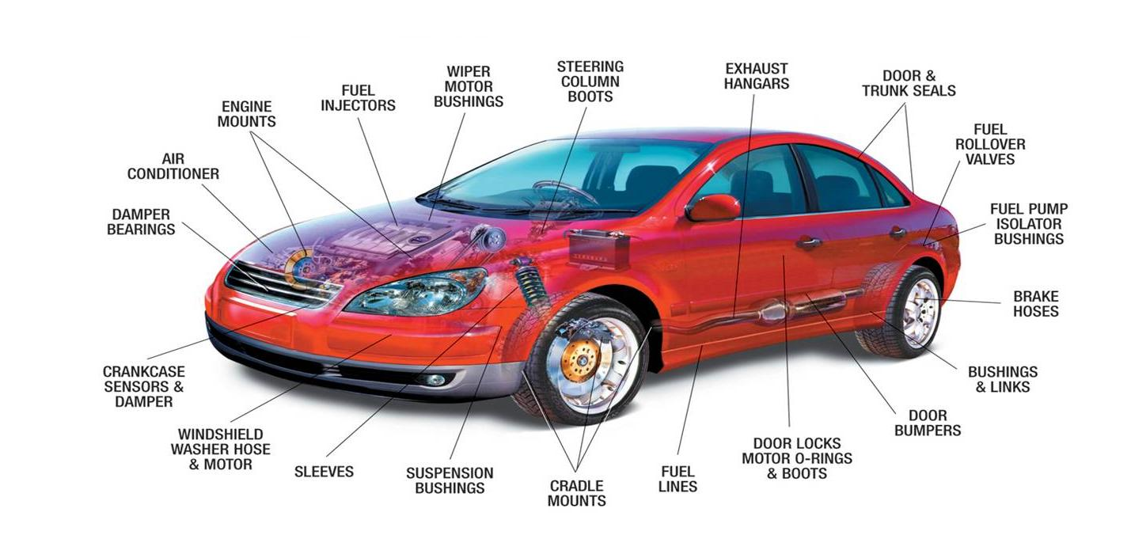
Typical Automotive Assembly Applications
EXHAUST
HANGERS
WINDOW

Slide 20
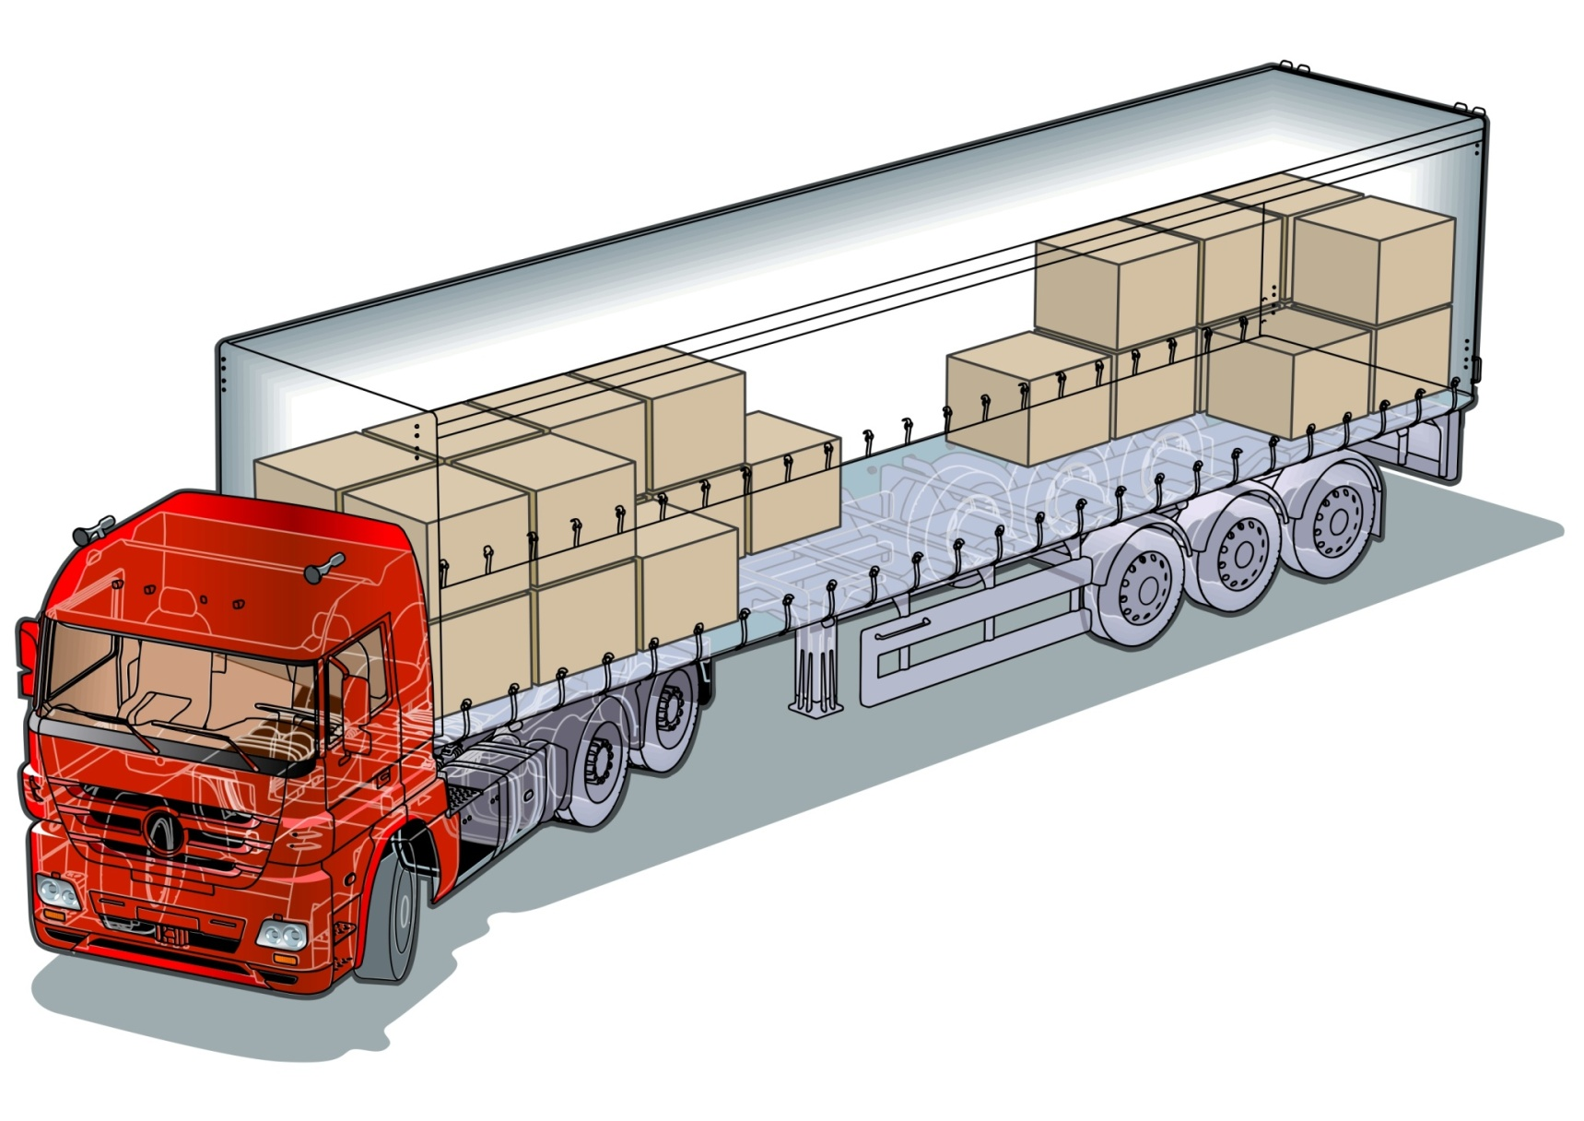
Typical Truck Assembly Applications
WEATHER SEALS (DOOR, WINDOW, CAB)
EXHAUST HANGER ISOLATORS
VIBRATION BUSHINGS
LUMBAR SUPPORT HOSES
HEATER HOSE
TIRE MOUNTING
5th WHEEL & BUSHINGS
SUSPENSION BUSHINGS
FUEL TANK STRAPS
BRAKE LINES
WIRE HARNESS-PULL
WINDSHIELD WASHER HOSES & PUMPS
TRANSMISSION COOLER LINES
AIR INTAKE HOSES

Slide 21
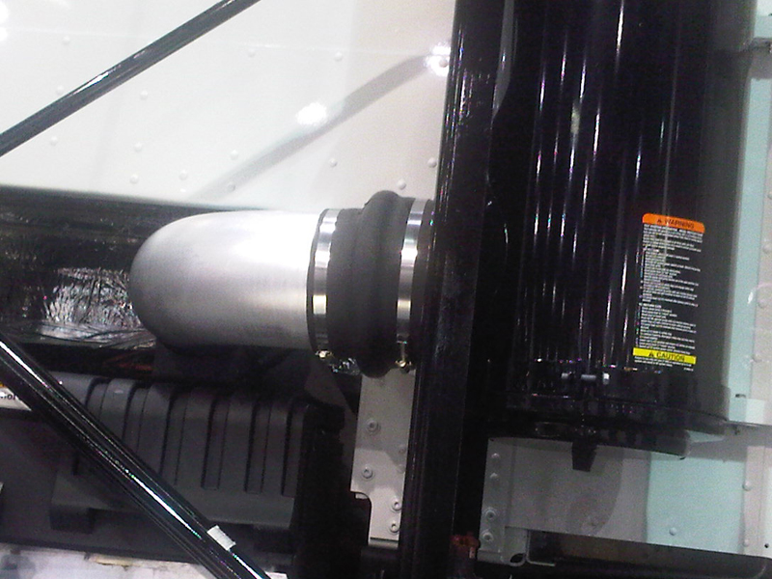
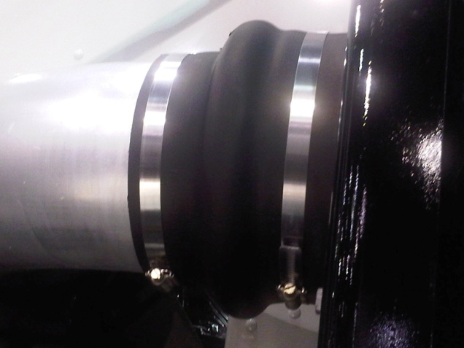
Typical Rubber Assemblies
BOOT ASSEMBLY
DRIVE SHAFT

Slide 22
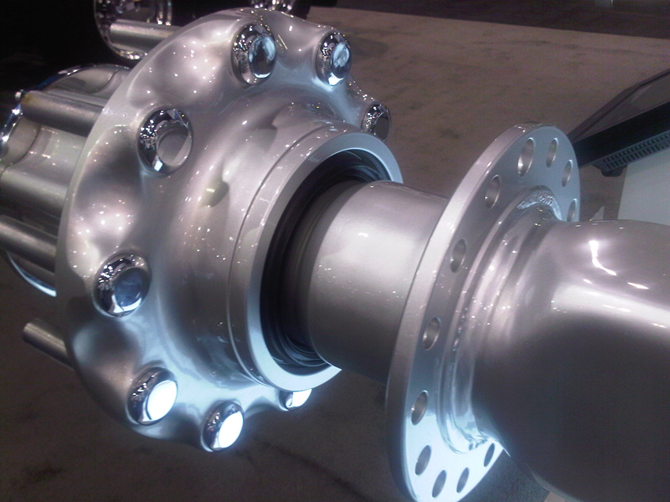
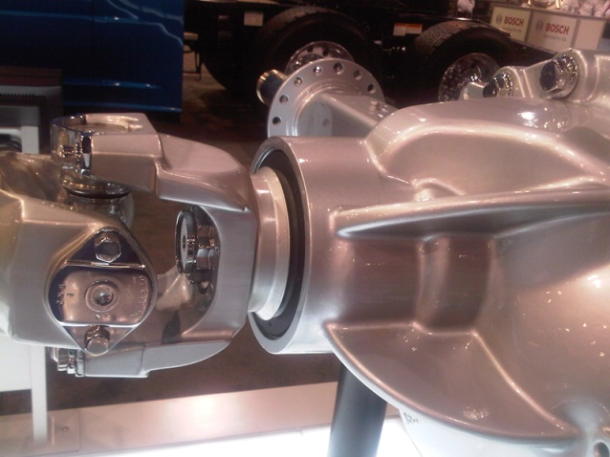
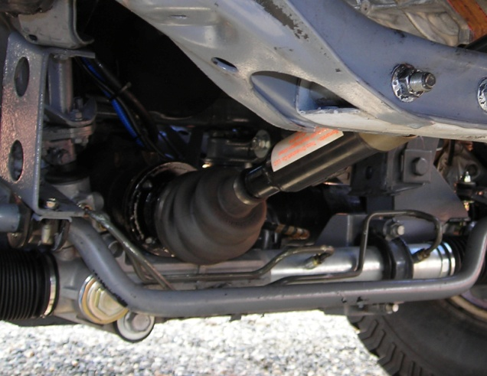
Typical Rubber Assemblies
SEAL ASSEMBLY
Drive shaft
Axle

Slide 23
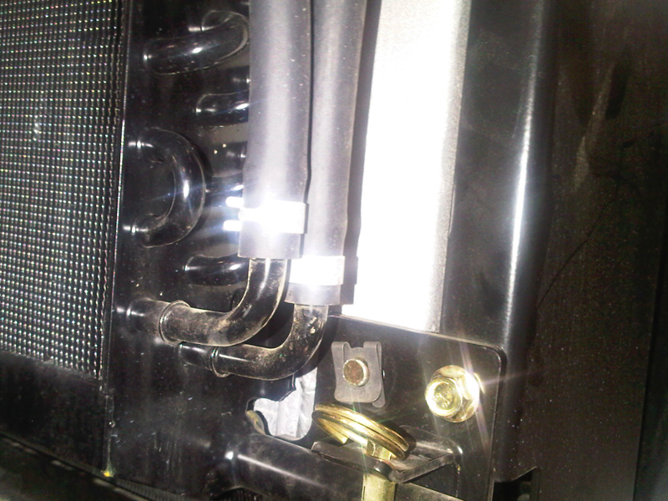
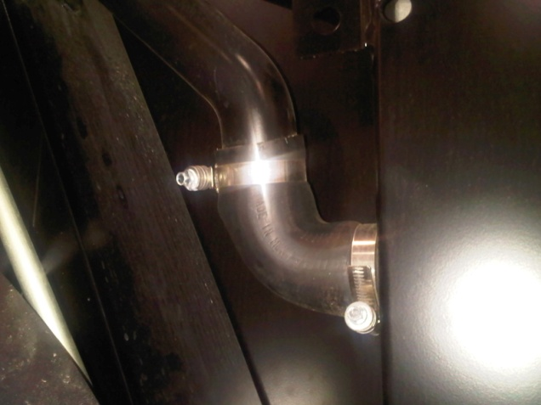
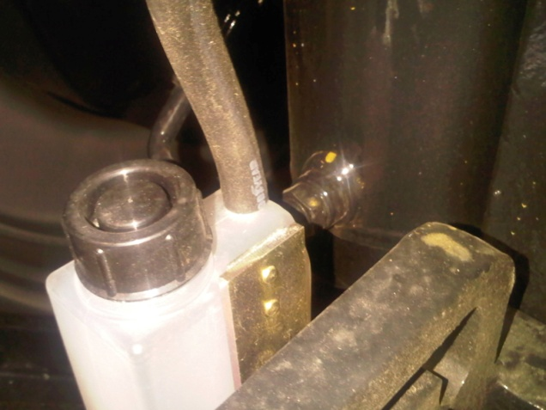
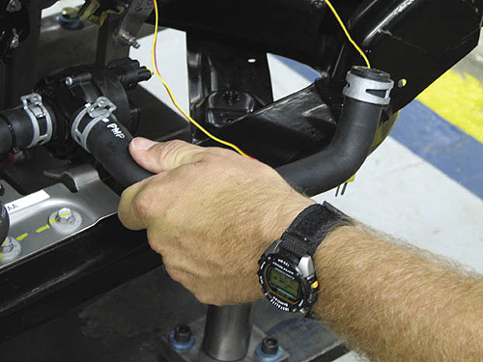
Typical Rubber Assemblies
HOSE FITTINGS
Radiator
Cooler
Fluid lines

Slide 24

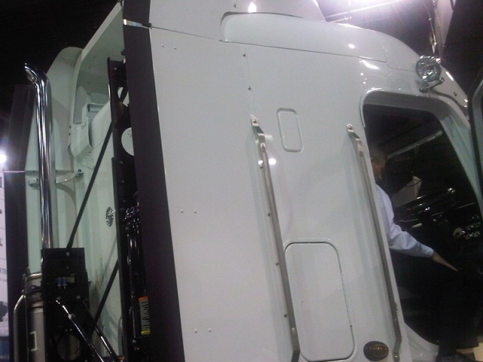
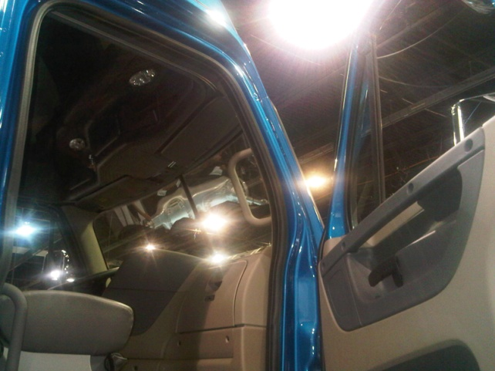
Typical Rubber Assemblies
DOOR SEALS
TRUNK SEALS
WINDOW SEALS
WEATHER STRIPING
SEALS

Slide 25
P-80® Storage and Handling
P-80® lubricants should be stored at temperatures between 2°— 30° (36°— 86°F) in the original sealed container. Do not store outdoors in direct sunlight during warm weather.
For proper inventory control, use oldest material first. Each container has a lot number that gives the date (yymmdd) that the material was produced. For instance, lot number 140105 was produced in 2014 (14), during January (01), on the fifth day (05). If your plant personnel know this dating system, they can avoid using new material while older stock is available. For shelf life, please refer to the appropriate Safety Data Sheet.
Before dispensing P-80 Emulsion and P-80 Emulsion IFC from drums, stir with a mixing recirculation pump or folding propeller mixer for 5 to 10 minutes to ensure a homogenous mixture is drawn off. If a hold tank is used, agitate the lubricant before it is fed to assembly equipment. Smaller containers should be shaken or stirred prior to use. Never use air agitation on any P-80 product. Bubbling compressed air through P-80 lubricants may introduce bacteria that can overpower the preservatives causing separation or spoilage.
Store P-80 lubricants in a sealed container when not in use. Do not pour dispensed product back into the original container.
P-80 Emulsion IFC and P-80 THIX IFC meet the requirements of 21 CFR 178.3570, which controls lubricants for incidental food contact. Use the minimum amount of lubricant needed to lubricate the part. Apply it in a way that minimizes food contact.
All equipment and storage tanks, including transfer lines, containers, reservoirs, mixers, and pumps in contact with P-80 lubricants should be cleaned at least once a month using a mild detergent such as International Products’ LF2100® Liquid Low-Foam Cleaner or Micro-90® Concentrated Cleaning Solution. Rinse with potable water. Samples of each cleaner are available from International Products Corporation. Follow cleaning with a sanitizer rinse (see section B for details). This procedure is particularly important in hot or dirty work areas.
Do not mix P-80 with other chemicals.
Do not dilute P-80 with water.
Excess P-80 can be wiped or washed away with soap and water.
For safety details and shelf life, please refer to the appropriate Safety Data Sheets.

Slide 26
P-80® Plastic Compatibility At Room Temperature
CONCLUSION: P-80 lubricants were found to be compatible with the plastics listed below when immersed for a total of ten days at room temperature.
Customers are encouraged to conduct their own tests before using P-80 lubricants.
PLASTIC | PROPERTY | 1 Day, %∆ |  |  |  |  | 10 Days, %∆
 |  | P-80 Emulsion | P-80 Thix | P-80 Grip-It | P-80 Redi- Lube | Tap Water | P-80 Emulsion | P-80 Thix | P-80 Grip-It | P-80 Redi-Lube | Tap Water
ABS | %∆ Mass %∆ Hardness %∆ Swell | + 0.2 - 2.5 + 0.4 | + 0.2 - 1.4 + 0.5 | + 0.2 - 0.4 + 0.1 | + 0.3 - 3.3 + 0.1 | + 0.2 -0.6 - 0.1 | + 0.3 - 1.2 + 0.1 | + 0.4 - 3.7 + 0.7 | + 0.5 + 0.6 0.0 | + 0.1 - 1.4 - 0.2 | + 0.4 - 1.5 - 1.1
Polymethyl Methacrylate* | %∆ Mass %∆ Hardness %∆ Swell | + 0.1 - 1.1 0.0 | + 0.2 + 0.7 + 0.3 | + 0.2 - 1.1 0.0 | + 0.2 - 1.4 + 0.1 | + 0.1 - 0.7 0.0 | + 0.5 - 1.8 + 0.3 | + 0.7 0.0 + 0.1 | + 0.7 - 0.5 + 0.2 | + 0.7 - 0.5 + 0.2 | + 0.5 - 2.5 - 0.4
Acetal | %∆ Mass %∆ Hardness %∆ Swell | + 0.1 0.0 + 0.2 | + 0.1 0.0 0.0 | + 0.1 - 1.3 0.0 | + 0.1 - 0.2 + 0.1 | + 0.1 + 0.6 0.0 | + 0.3 - 0.9 + 0.5 | + 0.4 - 0.4 + 0.2 | + 0.3 - 1.1 + 0.3 | + 0.3 - 0.2 + 0.1 | + 0.4 - 2.1 + 0.1
HDPE | %∆ Mass %∆ Hardness %∆ Swell | 0.0 - 2.8 - 0.1 | 0.0 - 2.3 + 0.3 | 0.0 + 1.1 - 0.1 | 0.0 - 2.1 - 0.4 | 0.0 + 3.4 + 0.1 | 0.0 - 5.6 - 0.2 | 0.0 - 4.9 + 0.1 | 0.0 + 2.7 - 0.2 | 0.0 - 2.3 - 0.6 | 0.0 - 0.8 + 0.5
PETG | %∆ Mass %∆ Hardness %∆ Swell | + 0.1 - 1.8 - 0.3 | + 0.1 - 0.9 + 0.1 | + 0.1 + 0.4 - 0.1 | + 0.1 0.0 0.0 | + 0.1 - 0.4 + 0.1 | + 0.2 - 2.5 + 0.1 | + 0.3 - 2.1 + 0.1 | + 0.2 - 1.7 - 0.2 | + 0.2 - 1.9 + 0.1 | + 0.2 - 3.1 + 0.1
Polycarbonate* | %∆ Mass %∆ Hardness %∆ Swell | + 0.1 - 1.2 0.0 | + 0.1 - 0.4 - 0.1 | + 0.2 + 0.2 0.0 | + 0.1 - 0.4 0.0 | + 0.1 - 0.8 - 0.1 | + 0.1 - 1.9 + 0.2 | + 0.2 - 1.2 0.0 | + 0.1 - 1.2 0.0 | + 0.1 + 0.6 + 1.0 | + 0.1 - 0.6 0.0
Polyetherimide | %∆ Mass %∆ Hardness %∆ Swell | + 0.2 - 0.7 + 0.1 | + 0.2 - 0.2 + 0.1 | + 0.1 + 0.5 - 0.1 | + 0.2 - 0.4 + 0.3 | + 0.2 - 0.9 - 0.1 | + 0.5 - 1.1 + 0.4 | + 0.7 - 0.4 + 0.4 | + 0.5 0.0 + 0.1 | + 0.4 - 0.2 + 0.2 | + 0.5 - 0.9 - 1.5
Polypropylene | %∆ Mass %∆ Hardness %∆ Swell | 0.0 - 1.9 + 0.5 | 0.0 - 1.5 0.0 | 0.0 + 4.1 0.0 | 0.0 0.0 - 0.1 | 0.0 + 4.1 - 0.6 | + 1.0 - 1.7 + 0.1 | 0.0 - 0.4 + 0.2 | 0.0 + 4.1 0.0 | 0.0 - 1.3 - 0.1 | 0.0 + 2.0 - 0.7
PPO* | %∆ Mass %∆ Hardness %∆ Swell | 0.0 - 0.4 0.0 | 0.0 - 0.9 - 0.1 | 0.0 + 0.2 + 0.1 | 0.0 - 0.6 - 0.2 | 0.0 + 0.2 + 0.4 | + 0.1 - 0.4 0.0 | 0.0 - 1.3 0.0 | + 0.1 + 0.2 0.0 | 0.0 + 0.6 - 0.3 | + 0.1 + 0.4 0.0
PVC | %∆ Mass %∆ Hardness %∆ Swell | 0.0 - 0.6 + 0.4 | 0.0 - 1.1 0.0 | 0.0 + 1.0 0.0 | 0.0 + 0.2 - 0.2 | 0.0 - 0.8 - 0.4 | + 0.1 - 0.6 0.3 | 0.0 - 0.8 0.0 | 0.0 + 0.4 0.0 | + 0.1 + 0.6 - 0.3 | + 0.1 - 0.6 - 0.4
Polytetra-fluoroethylene | %∆ Mass %∆ Hardness %∆ Swell | 0.0 + 2.0 - 0.1 | 0.0 + 1.3 0.0 | 0.0 - 3.9 - 0.4 | 0.0 - 2.6 0.0 | 0.0 + 7.9 - 0.5 | 0.0 - 0.3 + 0.2 | 0.0 + 0.3 + 0.2 | 0.0 - 3.6 - 0.4 | 0.0 - 2.0 0.0 | + 0.1 + 1.8 - 0.4
Polyamide 6 | %∆ Mass %∆ Hardness %∆ Swell | + 0.6 - 1.6 + 0.5 | + 0.7 - 2.2 + 0.4 | + 0.6 - 2.7 + 0.6 | + 1.4 - 3.4 + 0.5 | + 0.6 - 1.7 + 0.3 | + 2.2 - 8.6 +1.4 | + 2.4 -12.8 + 1.3 | + 2.3 - 8.6 + 1.3 | + 2.6 -10.7 + 1.3 | + 2.2 -11.5 + 1.2
KEY
ABS - Acrylonitrile butadiene styrene
HDPE - High Density Polyethylene
PETG - Polyethylene terephthalate
glycol-modified
PPO - Polyphenylene Oxide – Styrene
PVC - Polyvinyl chloride
*Under strain, these plastics may
show crazing.
METHOD Modified version of ASTM D543-95,
Practice A; Room Temp.
Mass: Analytical Balance, 0.0001 grams;
CoV – 4.0E-6%
Hardness: Shore D Durometer,
1 – 100 HD; CoV – 0.32%
Swell: Mitutoyo Micrometer, 0.001 mm,
CoV – 0.11%

Slide 27
P-80® Elastomer Compatibility At Room Temperature
CONCLUSION: While there are no standard specifications for excessive swell and hardness data, minimal changes are regarded as between
-5 to +20% and -5 to +10 points, respectively¹. (Vecchio, 2001) Based on these criteria, P-80 lubricants have acceptable swell and hardness compatibility
results after 10 days. Mass compatibility results are favorable compared to the tap water control samples.
Customers are encouraged to conduct their own tests before using P-80 lubricants.
ELASTOMER | PROPERTY | 1 Day, %∆ |  |  |  |  | 10 Days, %∆
 |  | P-80 Emulsion | P-80 Thix | P-80 Grip-It | P-80 Redi- Lube | Tap Water | P-80 Emulsion | P-80 Thix | P-80 Grip-It | P-80 Redi- Lube | Tap Water
Buna N | %∆ Mass ∆ Hardness, pts %∆ Swell | + 0.2 + 1.8 0.0 | + 0.2 + 0.2 - 0.3 | + 0.2 - 1.0 + 0.9 | + 0.9 - 1.0 + 0.1 | + 0.1 + 1.2 + 0.1 | + 0.9 + 0.5 - 0.2 | + 0.8 - 1.5 - 0.3 | + 0.7 - 1.2 + 0.1 | + 3.5 - 3.0 + 2.2 | + 0.2 + 2.7 - 0.8
Butyl | %∆ Mass ∆ Hardness, pts %∆ Swell | + 0.1 + 0.7 + 0.1 | + 0.1 - 0.7 + 0.5 | 0.0 - 4.3 - 0.1 | + 0.5 - 2.0 + 0.3 | 0.0 - 0.3 + 0.2 | + 0.4 - 2.1 - 0.5 | + 0.5 - 1.7 + 0.7 | + 0.2 - 1.2 - 1.1 | + 2.1 - 1.7 + 2.2 | + 0.1 - 0.5 - 0.2
ECH | %∆ Mass ∆ Hardness, pts %∆ Swell | + 0.4 - 0.7 - 0.5 | + 0.6 - 0.3 - 0.3 | + 0.7 - 4.0 - 0.1 | + 1.1 + 0.5 + 0.1 | + 0.4 + 4.7 + 0.3 | + 1.1 - 4.0 - 0.2 | +1.2 - 4.3 - 0.2 | + 2.2 - 1.3 + 0.6 | + 2.2 - 1.0 + 0.4 | + 1.4 + 4.8 + 0.8
EPDM | %∆ Mass ∆ Hardness, pts %∆ Swell | + 0.1 - 1.8 + 0.2 | + 0.1 - 2.3 - 0.3 | 0.0 - 3.7 + 0.4 | + 0.7 - 0.8 + 0.2 | 0.0 - 1.5 - 0.8 | 0.0 - 2.5 + 0.2 | + 0.6 - 5.3 - 0.2 | + 0.2 - 4.5 + 0.8 | + 2.6 - 1.8 + 0.9 | + 0.1 - 3.3 - 0.8
Natural Gum Rubber | %∆ Mass ∆ Hardness, pts %∆ Swell | + 0.1 - 1.8 - 0.1 | + 0.2 - 1.2 - 0.7 | + 0.4 - 2.2 + 0.5 | + 0.9 - 0.8 + 0.7 | + 0.1 + 1.3 + 0.0 | + 0.8 - 1.3 - 0.2 | + 1.2 - 3.3 - 0.6 | + 1.5 - 3.0 + 0.7 | + 4.4 - 3.8 + 1.7 | + 0.2 - 0.7 + 0.1
Neoprene | %∆ Mass ∆ Hardness, pts %∆ Swell | + 0.2 - 2.2 - 0.1 | + 0.3 + 0.5 + 0.3 | + 0.4 - 2.7 + 0.8 | + 1.1 - 2.3 0.0 | + 0.1 - 1.7 + 0.1 | + 1.2 - 4.7 + 0.8 | + 1.4 - 3.7 + 0.6 | + 1.5 - 4.7 + 1.1 | + 4.3 - 6.5 + 2.8 | + 0.5 - 3.5 - 0.1
SBR | %∆ Mass ∆ Hardness, pts %∆ Swell | + 0.2 - 2.8 + 0.1 | + 0.3 - 0.2 + 0.3 | + 0.2 - 2.2 - 0.1 | + 1.1 - 2.3 + 1.4 | + 0.1 + 4.0 + 0.1 | + 1.0 - 9.0 + 1.5 | + 1.2 - 2.0 + 1.2 | + 0.6 - 5.8 + 0.5 | + 4.2 - 7.8 + 5.2 | + 0.2 + 1.8 + 0.1
Silicone | %∆ Mass ∆ Hardness, pts %∆ Swell | + 0.3 - 2.2 - 0.1 | + 0.2 +0.2 + 0.6 | + 0.1 + 1.0 0.0 | + 1.2 - 4.1 + 0.2 | 0.0 + 0.7 + 0.4 | + 0.9 - 1.3 + 0.7 | + 1.0 - 0.3 + 0.9 | + 0.6 + 5.3 + 0.3 | + 4.9 + 4.2 + 5.0 | 0.0 - 0.7 + 0.6
Viton | %∆ Mass ∆ Hardness, pts %∆ Swell | + 0.1 - 2.2 - 0.1 | + 0.1 - 1.3 - 0.3 | 0.0 - 1.0 + 0.5 | + 0.1 - 3.8 - 0.5 | 0.0 + 1.3 - 0.1 | + 0.2 - 2.7 - 0.5 | + 0.3 - 3.0 0.0 | + 0.2 - 3.5 + 0.4 | + 1.1 - 1.8 + 0.8 | + 0.1 - 0..5 + 0.6

Slide 28
P-80® Metal Compatibility At Room Temperature
Customers are encouraged to conduct their own tests before using P-80 lubricants.
Underlined = Not Recommended *P-80 RESIDUE WILL DISCOLOR COPPER AND COPPER ALLOYS.
METAL | PROPERTY | 1 Day, %∆ |  |  |  |  | 14 Days, %∆
 |  | P-80 Emulsion | P-80 Thix | P-80 Grip-It | P-80 Redi- Lube | Tap Water | P-80 Emulsion | P-80 Thix | P-80 Grip-It | P-80 Redi- Lube | Tap Water
ALUMINUM 1100 | %∆ Mass | 0.00 | 0.00 | - 0.15 | - 0.01 | 0.00 | 0.00 | 0.00 | - 0.44 | - 0.02 | - 0.05
 | ∆ Appearance | No change | No change | Darker overall | No change | Several pinpoints | No change | No change | Black | No change | Pinpoints
*BRASS ALLOY 260 | %∆ Mass | - 0.01 | - 0.35 | - 0.04 | - 0.01 | 0.00 | - 0.02 | - 0.36 | - 0.47 | - 0.02 | 0.00
 | ∆ Appearance | No change | Dull finish | Faded Appearance | No change | Dark spots | Faded appearance | Darker outlines | Faded appearance | Dark spots | Dark spots
*BRONZE ALLOY 220 | %∆ Mass | - 0.01 | - 0.01 | - 0.04 | - 0.01 | 0.00 | - 0.02 | - 0.02 | - 0.50 | - 0.03 | 0.00
 | ∆ Appearance | No change | No change | Faded appearance | No change | Dark spots | Faded appearance | Dark spots | Faded appearance | Dark spots | Dark spots
1008 COLD ROLLED STEEL | %∆ Mass | 0.00 | 0.00 | - 0.01 | 0.00 | - 0.04 | 0.00 | 0.00 | - 0.06 | - 0.01 | - 0.47
 | ∆ Appearance | No change | No change | No change | No change | No change | No change | No change | Pinpoints | No change | Rust spots
*COPPER ALLOY CA 110 | %∆ Mass | - 0.01 | - 0.01 | - 0.05 | - 0.01 | 0.00 | - 0.02 | - 0.02 | - 0.51 | - 0.01 | 0.00
 | ∆ Appearance | No change | No change | Faded appearance | No change | Darker outlines | Faded appearance | Dark spots | Faded appearance | Dark spots | Darker outlines
MONEL 400 | %∆ Mass | 0.00 | 0.00 | 0.00 | 0.00 | 0.00 | - 0.01 | - 0.01 | 0.00 | - 0.01 | 0.00
 | ∆ Appearance | No change | No change | No change | No change | No change | No change | No change | No change | No change | No change
304 STAINLESS STEEL | %∆ Mass | 0.00 | 0.00 | 0.00 | 0.00 | 0.00 | - 0.01 | 0.00 | 0.00 | 0.00 | 0.00
 | ∆ Appearance | No change | No change | No change | No change | No change | No change | No change | No change | No change | No change
TITANIUM ALLOY, 8% Mn | %∆ Mass | 0.00 | 0.00 | 0.00 | 0.00 | 0.00 | 0.00 | - 0.01 | 0.00 | 0.00 | 0.00
 | ∆ Appearance | No change | No change | No change | No change | No change | No change | No change | No change | No change | No change

Slide 29


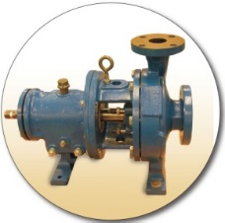




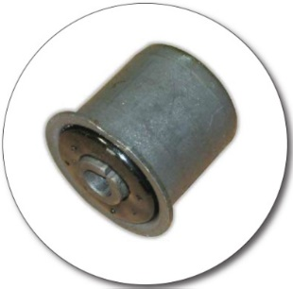
Contact us for product information and samples or a copy of this presentation International Products Corporation USA Headquarters 201 Connecticut Drive Burlington NJ 08016 USA Tel. 609-386-8770 Fax. 609-386-8438
Kathy Wyrofsky, President 609-386-8770 x213 kwyrofsky@ipcol.com
Tom McGuckin, VP Research and Quality 609-386-8770 x210 tmcguckin@ipcol.com
Michele Christian, Marketing Director 609-386-8770 x222 mchristian@ipcol.com
Judy Shapiro, Account Specialist 609-386-8770 x 217 jshapiro@ipcol.com
Website: www.ipcol.com U.K. Branch Unit 5 Green Lane Business Park 238 Green Lane - London SE9 3TL U.K. Tel. 0208 857 5678 Fax. 0208 857 1313 saleseurope@ipcol.com
Thank you!

